Slide 1

Analytics in banking
Will the client subscribe to a bank term deposit?
Analytics in banking
Will the client subscribe to a bank term deposit?
A_Team: Nikilesh, Alex, Rukshan, Rachel, Kassia

Slide 2


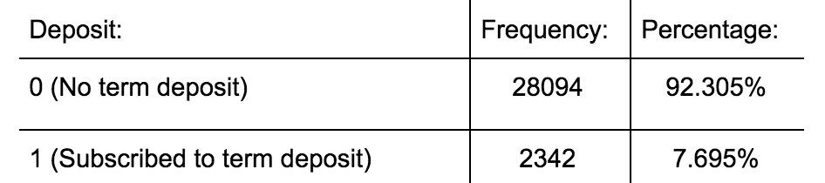
Introduction
Data set: related variables of direct marketing campaigns
run by a banking institution
based on multiple phone calls to prospective clients
Variables: age, education, marital status, and job, etc.
Goal: develop a classifier to predict the probability that a client will subscribe to a bank term deposit.

Slide 3

Generalized Linear Model (GLM)
Fit 1: glm(y ~ age + factor(marital) + factor(job) + factor(default) + factor(housing) + factor(loan) + factor(contact) + factor(month) + factor(day_of_week) + factor(poutcome) , family = "binomial", data = project_data)
AIC - 15533
Fit 0 : comprised all variables available
AIC - 15562
Methodology
minimised AIC, best performing glm
Fit 3 : glm(y ~ (age) + log(age) + factor(job) + factor(marital) + factor(default) + factor(month) + factor(day_of_week) + factor(poutcome) + factor(edu), family = binomial, data = data_train)
AIC - 15529
Fit 2 : glm(y ~ factor(job) + factor(contact) + factor(month) + factor(day_of_week) + factor(poutcome) + age + log(age) +(campaign) , family ="binomial", data = project_data)
AIC - 15502

Slide 4
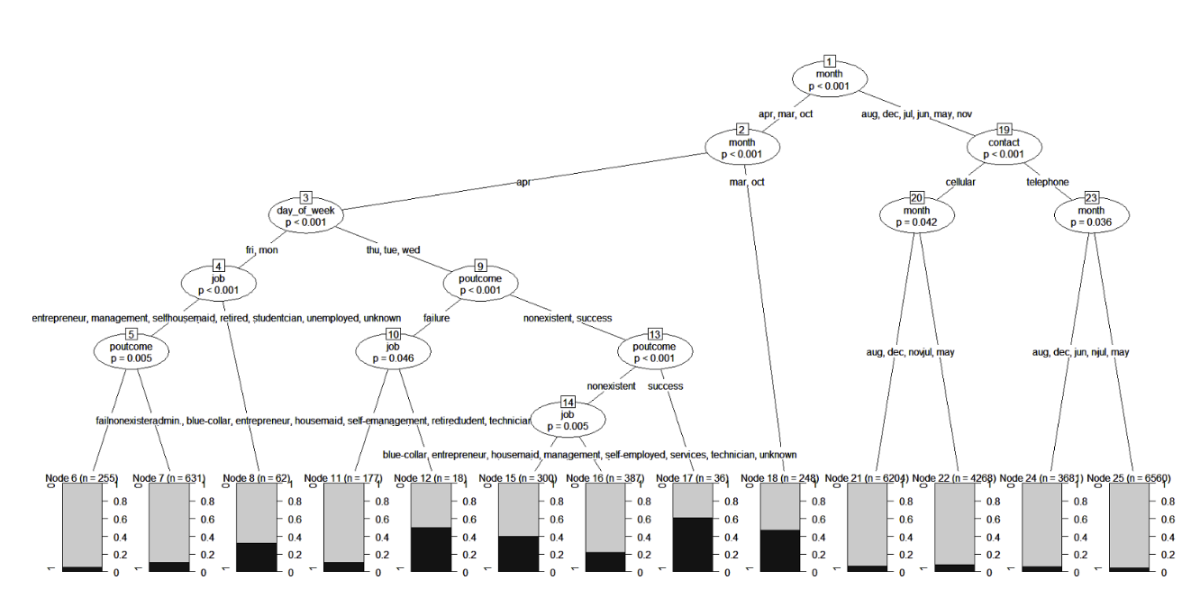
Decision Tree
What is a decision tree?
Suitability from this dataset
People who are most likely to subscribe (ones which received calls in April, on Tuesday, Wednesday or Thursday, and have previously subscribed to a marketing campaign)
Methodology

Slide 5
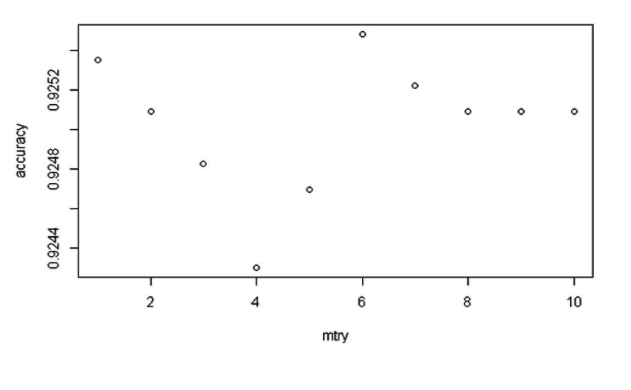
Random Forest
What are Random Forests?
Advantage and Disadvantages
Selection of hyper-parameters
Implementation
Methodology

Slide 6
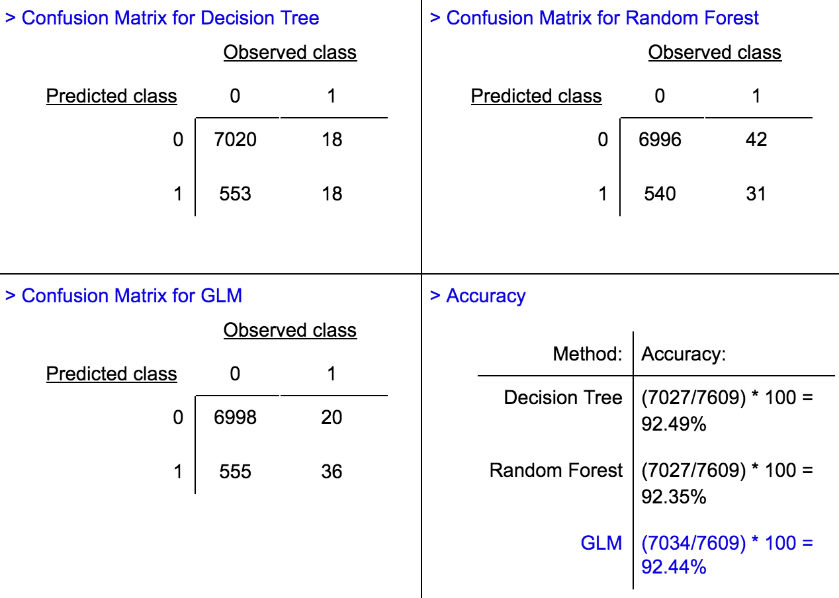
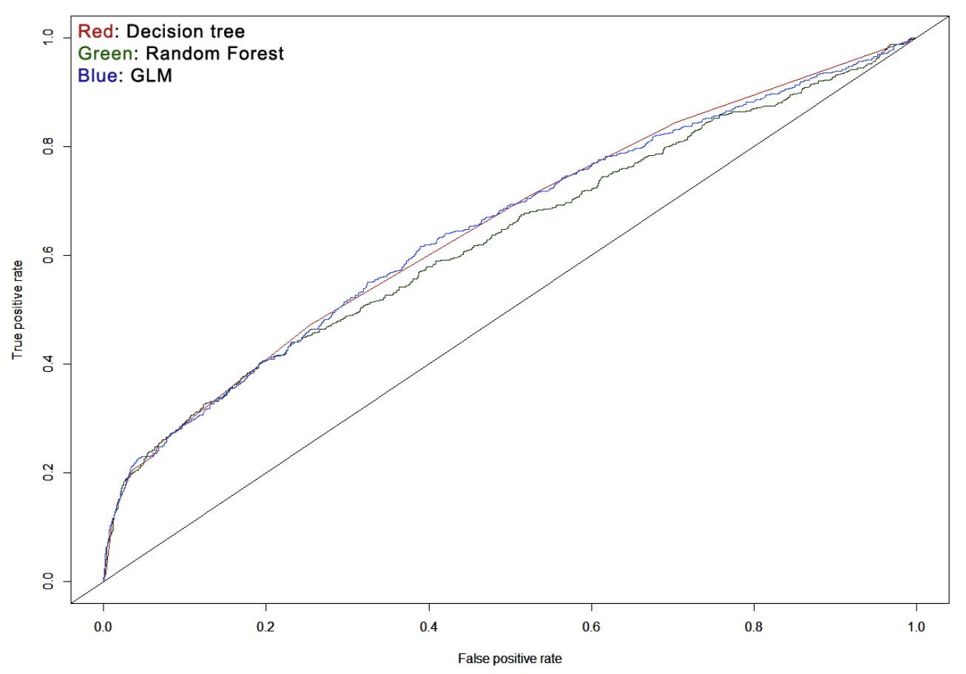
Results

Slide 7

Conclusion
model assessment criteria
prediction accuracy
AICC
ROC charts
AUROC
Winner: the decision tree (optimal prediction)
Kaggle’s Log-loss dark horse: GLM

Slide 8


